Slide 1

Credit Card Performance Report
Analyzing revenue, customer behavior, and growth opportunities

Slide 2

EXECUTIVE SUMMARY
Strong Momentum Across All Metrics
28.8%
57M
667K
Revenue Growth
Total Revenue
Transactions
Week-on-week increase
Year-to-date performance
Total volume processed

Slide 3
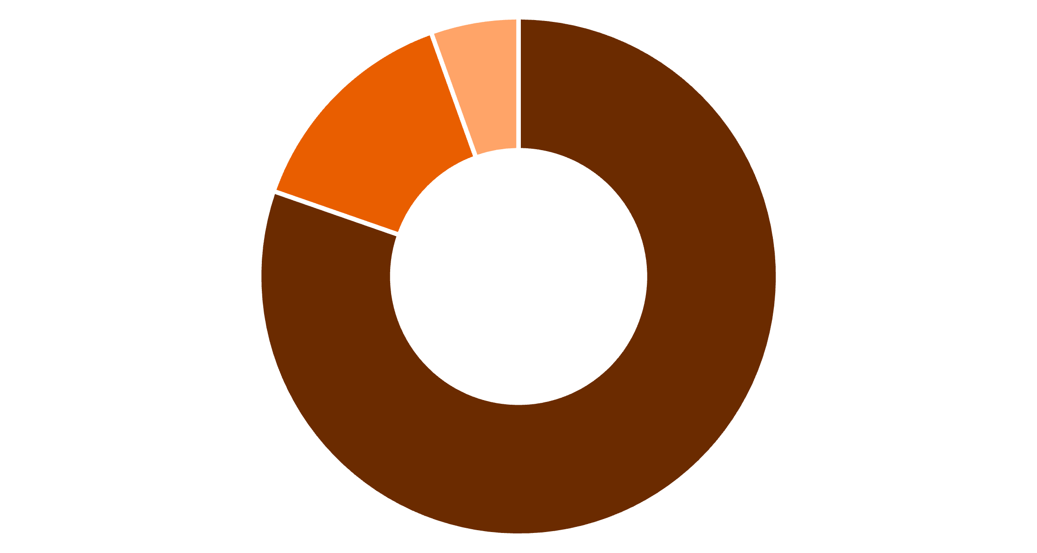
Year-to-Date Financial Performance
Revenue Breakdown
Transaction amount drives the majority of revenue at $46M, with interest earnings contributing $8M to total revenue of $57M.
Transaction Amount
Interest Earned
Other Revenue
$46M
$8M
Transaction Amount
Interest Earned

Slide 4



Customer Revenue Insights
Male Customers
Female Customers
High-Income Segment
$31M revenue contribution
$26M revenue contribution
$30M top revenue driver

Slide 5


PRODUCT PERFORMANCE
Card Category Distribution
93%
7%
Blue & Silver Cards
Other Cards
Transaction dominance
Remaining transactions
Premium Opportunity
Blue and Silver cards drive nearly all transaction volume, presenting opportunity for premium card expansion.

Slide 6
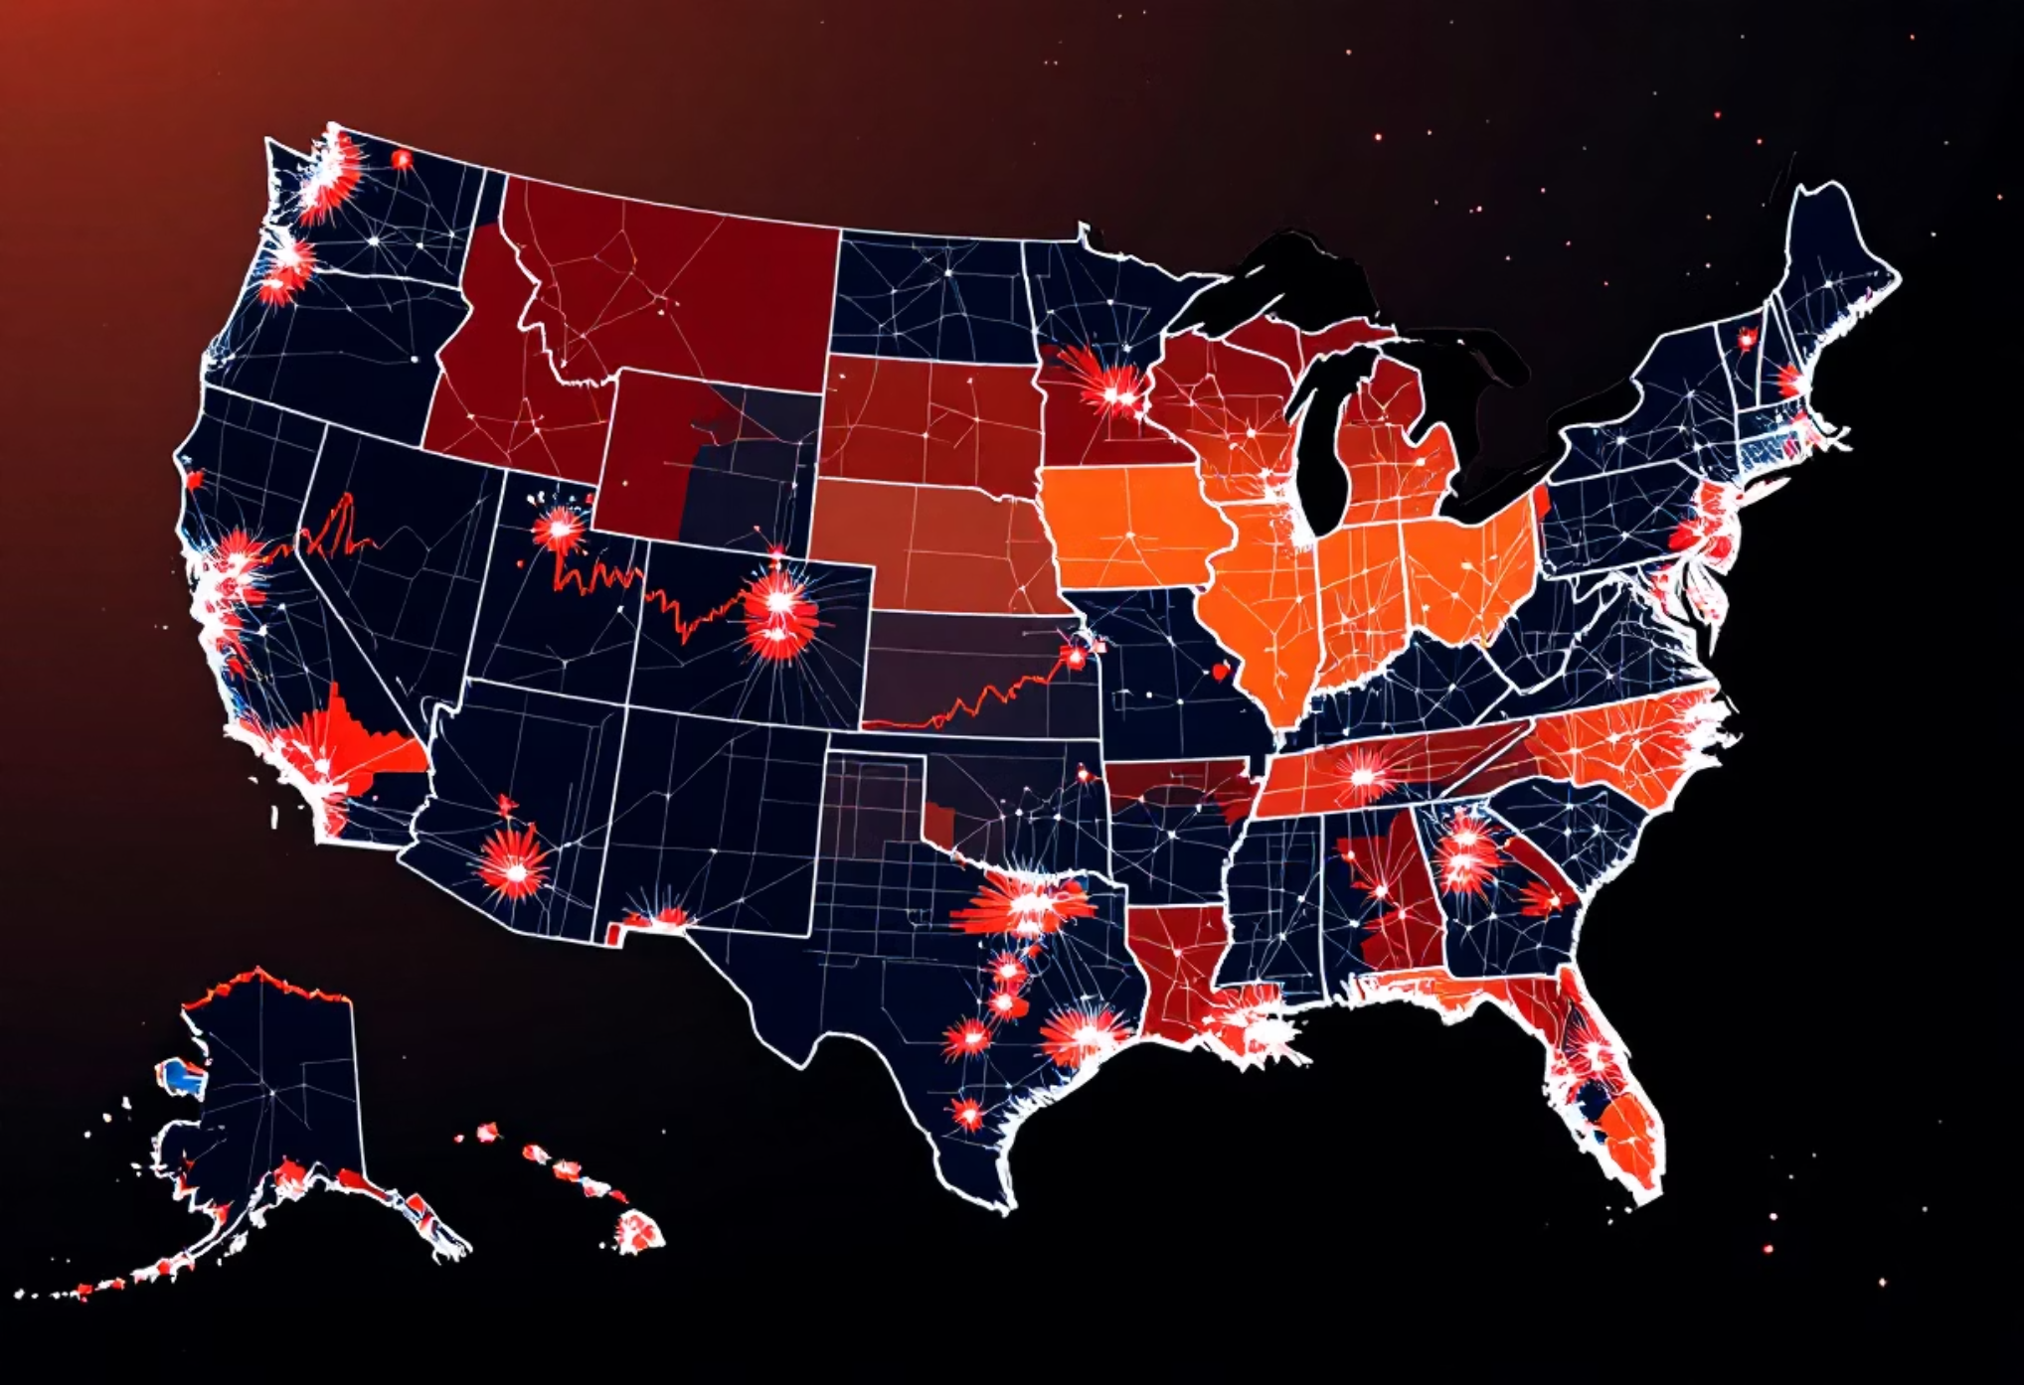
Geographic Revenue Leaders
Top 3 States Drive Growth
Texas, New York, and California collectively contribute 68% of total revenue, representing key markets for expansion.
1
Texas
2
New York
3
California
Leading revenue state
Strong metro performance
High-value market

Slide 7


Operational Health Metrics
Activation Rate
57.5% of cards activated
Opportunity to improve early conversion
Delinquency Rate
6.06% delinquent accounts
Monitor risk as volume grows

Slide 8



STRATEGY
Strategic Recommendations
Improve Activation
Scale Regions
Target Ages 40-60
Boost early conversion beyond 57.5%
Expand in TX, NY, CA markets
Focus on prime earning segments

Slide 9

Growth Acceleration Path
Risk Management
Monitor delinquency rates closely as transaction volume increases to maintain portfolio quality.
Optimize Activation
Expand Premium
Premium Focus
Scale Regions
Expand beyond Blue & Silver cards to capture higher-value customer segments.
Sequential approach to sustainable growth and market expansion

Slide 10

Strong Momentum, Clear Path Forward
28.8% Growth
$57M Revenue
Week-on-week revenue increase
Year-to-date performance
Focused Strategy
Activation, expansion, risk control

